Slide 1

LinkedIn Job Market & Hiring Insights Dashboard

Slide 2

INTRODUCTION
LinkedIn is a primary channel for hiring, but extracting meaningful insights from its vast job data is challenging for both job seekers and recruiters.
The Challenge
Scattered information on trends, skills, salaries, and competition.
Our Solution
An interactive Power BI dashboard to analyze and present LinkedIn job market data.

Slide 3
PROBLEM STATEMENT
Job seekers and recruiters lack clear visibility into market trends, skills, salaries, and competition due to
fragmented data.
Fragmented Data
No Centralized View
Inconsistent Salary Data
Scattered information makes data-driven decisions challenging.
Difficulty in tracking hiring trends, skill demand, and role growth.
Challenges in comparing salaries across roles, locations, and industries.

Slide 4
DATASET OVERVIEW
Source: Kaggle – LinkedIn Job Dataset
Total Tables: Multiple related tables
Central Fact Table: Postings
Key Tables:
Postings – Job details including title, experience level, salary range, location, job type, and listed date
Companies – Company information and location details
Industries– Industry classification for each job
Salaries – Salary ranges and compensation types
Skill Domain– Required skills per job
Benefits – Job benefits
Employee Counts – Company size indicators

Slide 5
DATA TRANSFORMATION
Renamed columns, removed duplicates.
Standardized country codes, city names.
Filtered irrelevant rows, created curated city lists.
Converted data types, normalized salary values to USD.
Cleaned text fields for accuracy and consistency.

Slide 6
DATA MODELING
A structured relational data model in Power BI efficiently connects job postings with related dimensions.
Star Schema Approach
Key Aspects
Benefits
Job Postings as the central fact table.
Job ID as primary key, one-to-many relationships, separate dimension tables.
Optimized relationships for accurate aggregation, improved performance, and scalability.

Slide 7
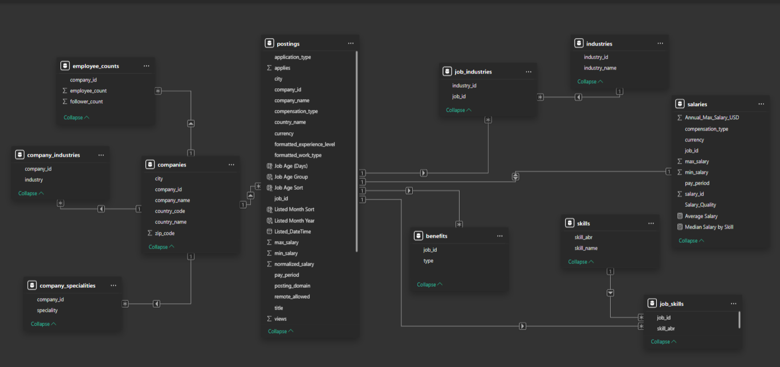

Slide 8
TECHNOLOGY USED
1
Excel
Initial data inspection, formatting, and handling missing values.
2
ETL Process
Extracting, transforming, and loading LinkedIn job data into Power BI.
3
Power BI
Data modeling, interactive dashboard development, and KPI cards.

Slide 9
KEY BUSINESS QUERIES
What is the total number of active job postings in the market?
How many unique companies are currently hiring?
What is the average salary offered across all job postings (USD)?
How competitive is the job market (average applications per job)?
What percentage of job postings are remote vs on-site?
Which industries have the highest number of job postings?
What is the monthly trend in job postings?
What share of job postings comes from each skill domain?
How does average salary vary by experience level?
Which cities have the most job opportunities?
Which companies post the most jobs?

Slide 10
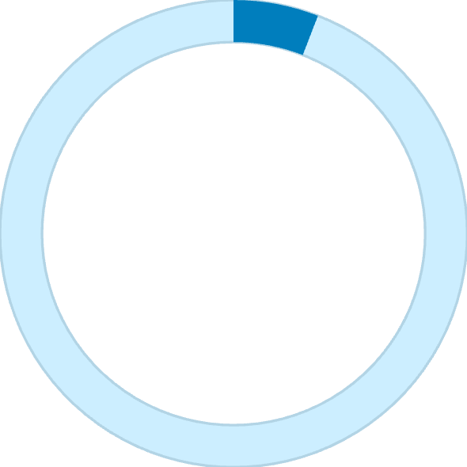
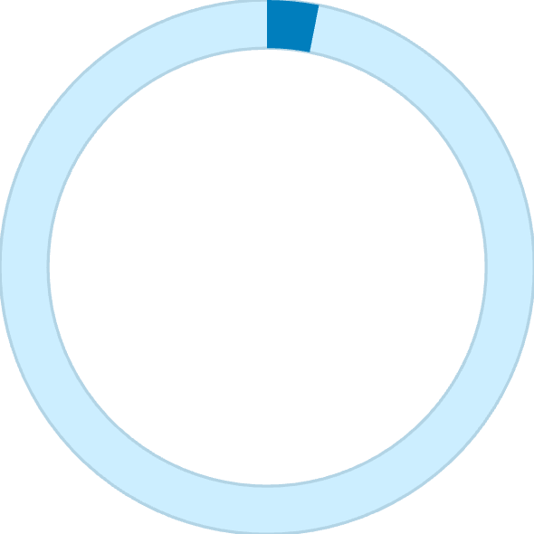

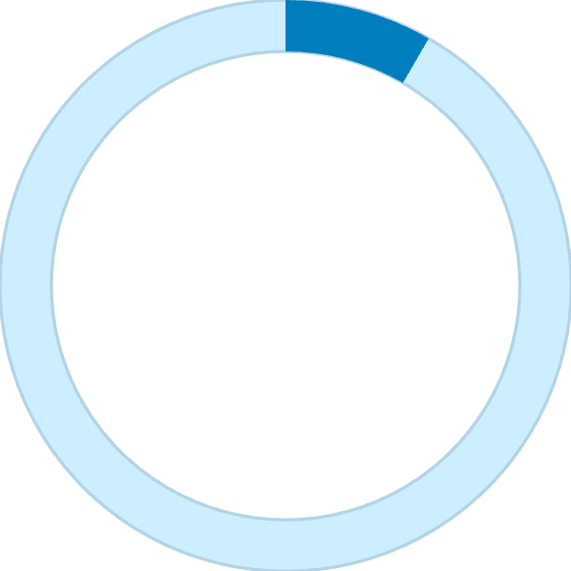
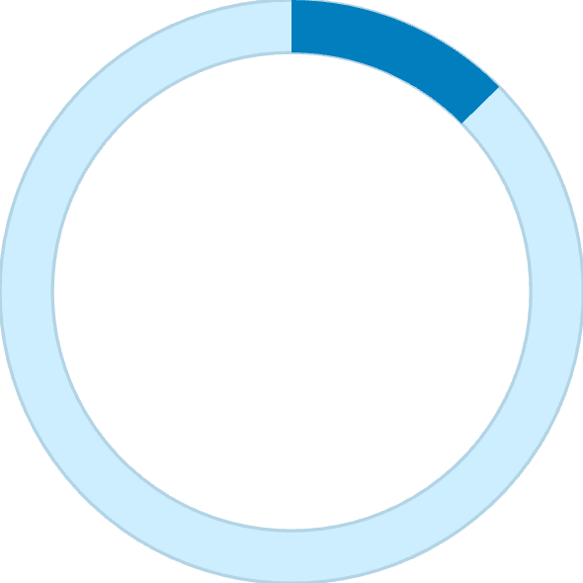
KEY METRICS
5.88K
3.11K
$255K
Total Active Job Postings
Hiring Companies
Average Salary (USD)
8.35
12.6%
Average Applications Per Job
% Remote Jobs

Slide 11
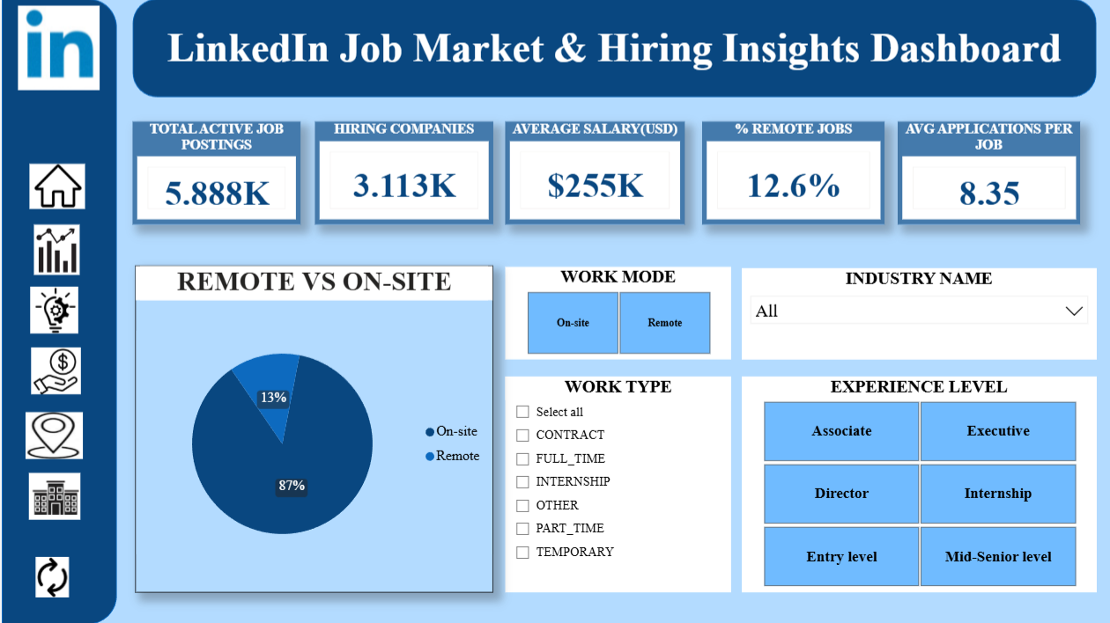
DASHBOARD OVERVIEW

Slide 12
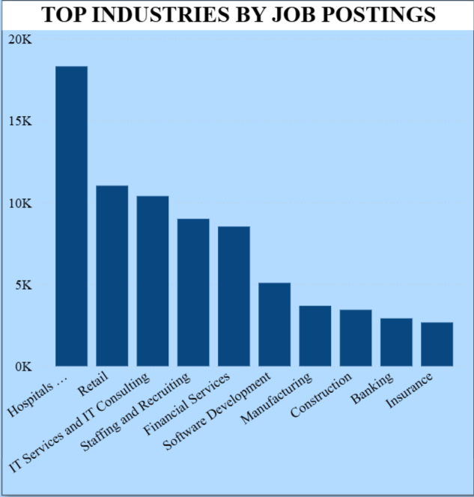
VISUALIZATIONS
Explain: This chart displays the number of job postings across various industries, showing the distribution of hiring demand.
Why this chart: A column chart is used because it allows easy comparison between industries and clearly highlights differences in job availability.
Insight: Healthcare, Retail, and IT-related industries have the highest number of job postings, indicating strong hiring demand in these sectors.

Slide 13
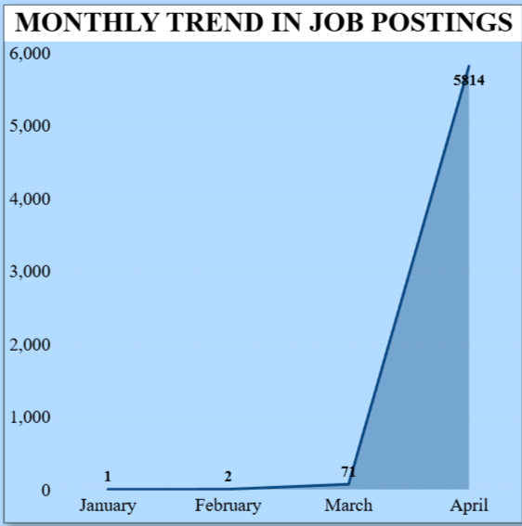
Explain: This chart shows the month-wise variation in the number of job postings over a specific time period.
Why this chart: A line chart is ideal for time-based data as it clearly highlights trends, growth patterns, and sudden changes in job postings across months.
Insight: Job postings remain low during January and February, show a slight increase in March, and then rise sharply in April, indicating a significant surge in hiring activity.

Slide 14
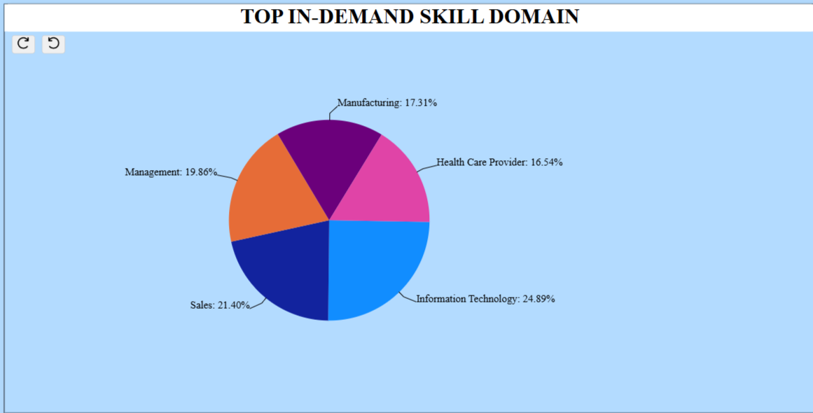
Explain: This chart shows the percentage distribution of job demand across different skill domains such as Information Technology, Sales, Management, Manufacturing, and Healthcare.
Why this chart: A pie chart is used to represent part-to-whole relationships. It helps clearly show how overall skill demand is divided among various domains.
Insight: Information Technology leads skill demand, followed by Sales and Management, with steady demand across other domains.

Slide 15
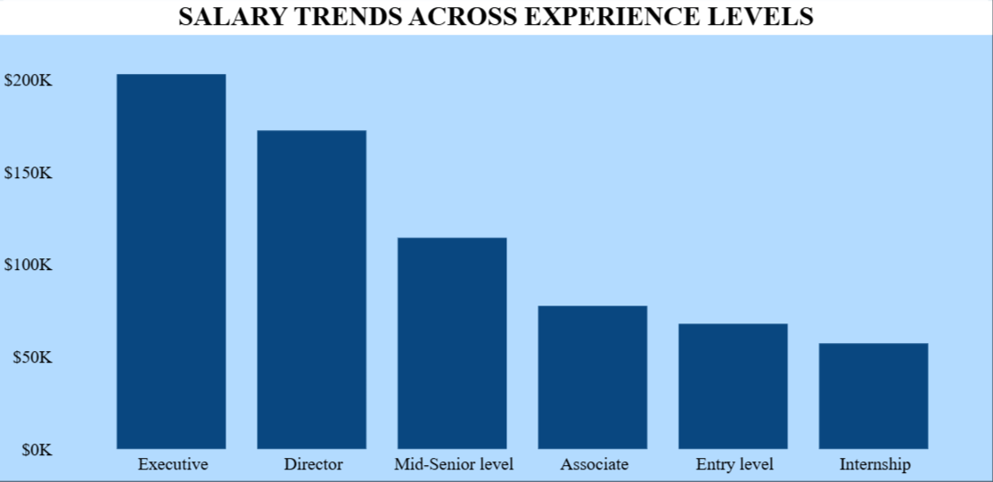
Explain: This chart shows the average salary offered across different experience levels, ranging from internship to executive roles.
Why this chart: A bar chart is effective for comparing salary levels across experience categories, making differences in compensation easy to understand.
Insight: Salaries increase significantly with experience, with executive and director roles earning the highest pay, while entry-level and internship roles receive comparatively lower salaries.

Slide 16
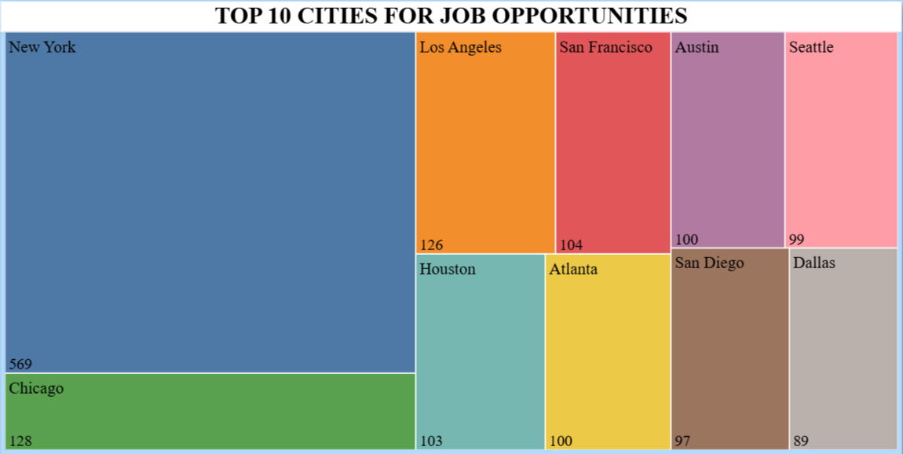
Explain: This treemap visualizes the distribution of job opportunities across the top 10 cities, where the size of each block represents the number of job postings.
Why this chart: A treemap is used to compare multiple categories in a limited space. It effectively highlights cities with higher job availability while showing relative differences among all top cities.
Insight: New York has the highest number of job opportunities by a large margin, followed by Chicago and Los Angeles, indicating that major metropolitan cities dominate the job market.

Slide 17
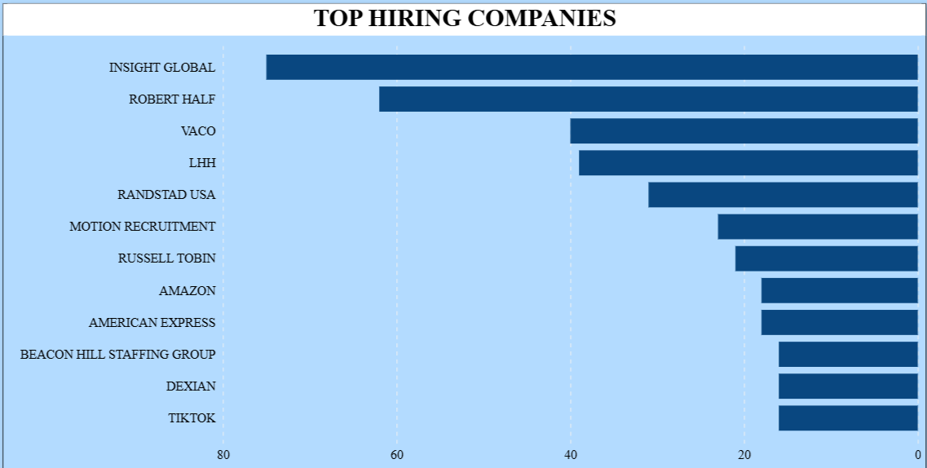
Explain: Displays the top hiring companies, where bar length indicates the total number of job postings and companies are ranked from highest to lowest.
Why this chart: A horizontal bar chart allows quick comparison, clear ranking, easy readability of long company names, and highlights hiring differences effectively.
Insight: Insight Global leads hiring, followed by Robert Half. Staffing and recruitment firms dominate the top positions, showing they generate most job opportunities, while direct employers have comparatively lower hiring volumes.

Slide 18

CONCLUSION
The LinkedIn Job Market & Hiring Insights Dashboard transforms complex data into interactive, actionable intelligence.
Empowers Job Seekers
Optimizes Hiring
Informed career decisions based on market insights.
Recruiters can understand market dynamics and refine strategies.
Strategic Decisions
Faster, smarter, data-driven choices for all users.

Slide 19

Thank You!!

